Slide 1
Apache Maven
A Complete Beginner's Guide to Build Automation, Architecture, Lifecycles, and CLI Commands
INT 331 – Unit 3

Slide 2
1. INTRODUCTION
Maven Automates Java Build Pipelines Through Project Object Models
Traditional Build Challenges
• Manual Library Tracking: Developers manually download JARs and commit binary files to source control.
• Classpath Inconsistencies: Projects break when developer machines have subtle classpath variations.
• Imperative Build Scripts: Tools like Ant require explicitly scripting every compilation and copying step.
• No Standard Layout: Every project organizes source code, tests, and outputs differently.
The Maven Solution
• Declarative POM File: Project configuration is declared in a single pom.xml file.
• Automated Dependency Resolution: Maven automatically fetches required JARs and transitive libraries from repositories.
• Standard Directory Layout: Enforces a uniform directory structure so developers instantly understand any codebase.
• Predefined Lifecycles: Provides built-in lifecycle phases (compile, test, package, deploy).

Slide 3
1. INTRODUCTION
Convention Over Configuration Eliminates Boilerplate Build Scripting
Convention over Configuration
Default project layouts and build behaviors eliminate thousands of lines of custom build scripts across projects.
Centralized Dependencies
Transitive dependency trees are resolved automatically from central or remote repositories with full version locking.
Extensible Plugin Ecosystem
Build phases delegate actual work to decoupled plugin goals (e.g. Compiler, Surefire, Exec, Javadoc).
Reproducible Builds
Strict coordinate management guarantees identical artifact outputs across developer workstations and CI/CD pipelines.

Slide 4
1. INTRODUCTION
Declarative Specifications Outperform Procedural Imperative Scripts
Feature Dimension | Apache Ant | GNU Make | Apache Maven
Build Style | Procedural (XML targets) | Procedural (Makefile rules) | Declarative (POM Object Model)
Dependency Management | Manual / Third-party (Ivy) | Manual system paths | Automated (Central & Local Repos)
Project Structure | Custom per project | Custom per Makefile | Standardized Directory Layout
Reusability | Low (copy-paste scripts) | Low (custom shell code) | High (Reusable Plugins & Parents)

Slide 5
2. PROJECT LAYOUT
Standardized Directory Structure Guarantees Instant Codebase Familiarity
my-app/
├── pom.xml # Project descriptor
└── src/
├── main/
│ ├── java/ # Main Java sources
│ ├── resources/ # App config & assets
│ └── webapp/ # Web app files (WAR)
└── test/
├── java/ # Unit test sources
└── resources/ # Test config data
└── target/ # Generated build outputs
├── classes/ # Compiled .class files
└── my-app-1.0.jar # Final artifact
src/main/java
Contains production Java source files matching package hierarchy (e.g., com/example/App.java).
src/main/resources
Holds classpath resources such as application.properties, XML configs, and assets.
src/test/java
Houses unit & integration test classes (JUnit / TestNG) excluded from final production package.
src/test/resources
Mock data and configuration properties required strictly during testing phases.
target/
Output directory created during build containing compiled bytecode, reports, and packaged JAR/WAR files.
Apache Maven Beginner Guide | Slide 5 of 20

Slide 6
2. PROJECT CONFIGURATION
The Project Object Model (pom.xml) Serves as the Single Source of Truth
<project xmlns="http://maven.apache.org/POM/4.0.0">
<modelVersion>4.0.0</modelVersion>
<groupId>com.example.app</groupId>
<artifactId>my-app</artifactId>
<version>1.0.0-SNAPSHOT</version>
<packaging>jar</packaging>
<dependencies>
<dependency>
<groupId>org.junit.jupiter</groupId>
<artifactId>junit-jupiter</artifactId>
<version>5.9.2</version>
<scope>test</scope>
</dependency>
</dependencies>
</project>
<project> & <modelVersion>
Root element defining XML schema. Version 4.0.0 is standard for Maven 2 & 3.
<groupId>
Uniquely identifies project developer or organization (usually reverse domain name).
<artifactId>
Name of the binary output file generated by the project (e.g. my-app).
<version>
Specific version release tag (SNAPSHOT signifies an active development build).
<dependencies>
Container block declaring external third-party libraries required for build/runtime.
Apache Maven Beginner Guide | Slide 6 of 20

Slide 7
2. PROJECT CONFIGURATION
Group, Artifact, and Version (GAV) Form Unique Coordinate Identifiers
groupId
Organization Identifier (Example: com.google.guava)
Defines the parent organization or package hierarchy. Prevents library naming collisions.
artifactId
Project Binary Name (Example: guava)
The specific module or library name. Forms the base name of the generated output file.
version
Release / State Tag (Example: 31.1-jre)
Tracks project iterations. SNAPSHOT indicates unstable dev builds; numeric tags indicate final releases.
Repository Storage Path Formula: ~/.m2/repository/{groupId}/{artifactId}/{version}/{artifactId}-{version}.jar
Apache Maven Beginner Guide | Slide 7 of 20

Slide 8
3. ARCHITECTURE
Maven Coordinates Project Descriptors, Repositories, and Plugin Execution
1. User CLI Command
Developer executes command:
'mvn clean package'
2. Core Engine & POM
Maven reads pom.xml,
builds effective model & dependency graph
3. Repository Resolution
Checks Local Repo;
downloads missing JARs from Central/Remote
4. Plugin Goal Execution
Binds goals to requested phase & executes compiled tasks
Apache Maven Beginner Guide | Slide 8 of 20

Slide 9
3. ARCHITECTURE
A Three-Tiered Repository Model Resolves and Caches Project Artifacts
Local Repository
Location: ~/.m2/repository
First stop for dependency resolution. Caches all downloaded dependencies and locally installed artifacts on developer workstation.
Central Repository
Location: repo.maven.apache.org
Global public repository hosted by Apache community. Contains millions of open-source Java libraries and frameworks.
Remote / Corporate Repo
Location: Nexus / Artifactory
Private enterprise repository hosted on internal networks. Houses proprietary corporate code and proxies central downloads.
Apache Maven Beginner Guide | Slide 9 of 20

Slide 10
4. DEPENDENCY MECHANISM
Transitive Resolution Manages Library Trees and Conflict Mediation
TRANSITIVE DEPENDENCY GRAPH
Your Project (my-app)
└── Direct Dependency: Spring Boot 3.0
├── Transitive: Jackson Core 2.14
└── Transitive: Spring Context 6.0
└── Transitive: Spring AOP 6.0
★ Maven automatically downloads Jackson & AOP
without requiring explicit POM declarations!
Dependency Mediation Rules
• Nearest Definition Rule: Maven selects the version closest to the root project in the dependency tree. (Depth 1 overrides Depth 2).
• First Declaration Wins: If two conflicting versions are at the same depth, the dependency declared first in the POM wins.
• Explicit Override: Declaring a dependency version directly in your project POM always overrides any transitive resolution.
Apache Maven Beginner Guide | Slide 10 of 20

Slide 11
4. DEPENDENCY MECHANISM
Dependency Scopes Control Classpath Inclusion Across Build Phases
Scope | Classpath Inclusion | Transitive? | Typical Use Case Example
compile | Compile, Test, Runtime (All) | Yes | Core utility libraries (e.g., Apache Commons, Guava)
provided | Compile, Test (Not Package) | No | Servlet API, JDK features provided by application container
runtime | Test, Runtime (Not Compile) | Yes | JDBC Database Drivers (e.g., PostgreSQL, MySQL driver)
test | Test Classpath Only | No | Testing frameworks (JUnit 5, Mockito, AssertJ)
system | Compile, Test (Local Path) | No | Legacy unmanaged local JARs specified via <systemPath>
Apache Maven Beginner Guide | Slide 11 of 20

Slide 12
5. BUILD LIFECYCLES
Three Standard Lifecycles Structure Cleanup, Build Processing, and Documentation
1. Clean Lifecycle
CLI: mvn clean
Responsible for purging previous build outputs, temporary class files, and packaged JAR artifacts from the target/ directory.
2. Default Lifecycle
CLI: mvn build / package
The main execution lifecycle comprising 23 sequential phases. Handles validation, compilation, testing, packaging, and distribution.
3. Site Lifecycle
CLI: mvn site
Generates web documentation, HTML pages, Surefire unit test reports, and dependency metrics for the project.
Apache Maven Beginner Guide | Slide 12 of 20

Slide 13
6. LIFECYCLE PHASES
The Clean Lifecycle Wipes Target Outputs to Ensure Uncontaminated Compilations
pre-clean
Executes preparation steps prior to actual project cleaning (e.g. archiving previous build logs).
clean
Removes all files generated by previous builds by deleting target/ output directory.
post-clean
Executes post-cleaning notifications, cleanup validation, or environment resets.
Apache Maven Beginner Guide | Slide 13 of 20

Slide 14
6. LIFECYCLE PHASES
Validation, Source Compilation, and Unit Testing Form the Initial Build Pipeline
validate
compile
test-compile
test
Checks project structure correctness and verifies all required POM metadata is present.
Compiles application Java source files from src/main/java into target/classes.
Compiles unit test source files from src/test/java into target/test-classes.
Runs compiled unit tests using testing framework (e.g. JUnit). Fails build if tests fail.
Apache Maven Beginner Guide | Slide 14 of 20

Slide 15
6. LIFECYCLE PHASES
Packaging, Verification, and Local/Remote Distribution Complete the Build
package
verify
install
deploy
Bundles compiled bytecode and resources into distributable format (JAR, WAR, EAR).
Executes integration checks to ensure quality criteria and security metrics are met.
Installs final package into local repository (~/.m2) for use as local dependency.
Copies final artifact package to remote corporate repository (Nexus) for team sharing.
Apache Maven Beginner Guide | Slide 15 of 20

Slide 16
6. LIFECYCLE PHASES
Site Lifecycle Automates Project Web Portal Generation and Reporting
pre-site
Executes preliminary tasks required before generating site documentation.
site
Generates HTML project documentation, Javadoc API guides, and code metrics.
post-site
Finalizes site generation and prepares documentation bundle for deployment.
site-deploy
Deploys generated site documentation to designated web server or server pool.
Apache Maven Beginner Guide | Slide 16 of 20

Slide 17
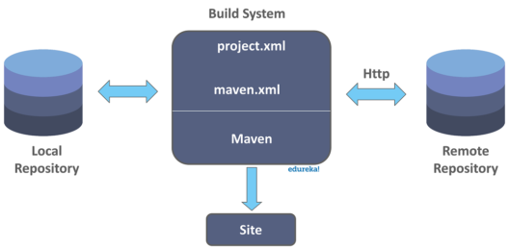
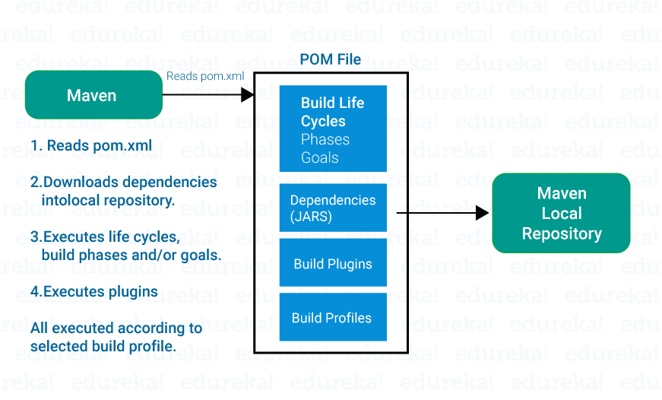
Maven Architecture

Slide 18
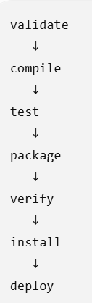
Maven Lifecycle → contains Phases → each Phase executes Goals
1. Maven Lifecycle
A lifecycle is a complete sequence of steps Maven follows to build a project.
Lifecycle | Purpose
clean | Clean/remove previous build files
default | Build, test and package the application
site | Generate project documentation/site
Maven has three built-in lifecycles:

Slide 19
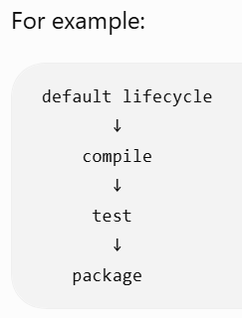
2. Maven Phase
A phase is one step in a lifecycle.
When we run command
mvn compile
you are asking Maven to execute the compile phase.
And when you run
mvn package
Maven doesn't execute only package.
It executes all required phases before it:
validate
↓
compile
↓
test
↓
package

Slide 20
3. Maven Goal
A goal is the actual task performed by a Maven plugin.
For example:
maven-compiler-plugin
↓
compile goal
Another example:
maven-surefire-plugin
↓
test goal
Another:
maven-jar-plugin
↓
jar goal

Slide 21
7. PLUGIN ARCHITECTURE
Plugin Goals Carry Out Actual Work Bound to High-Level Lifecycle Phases
Phases vs Goals Architecture
A Lifecycle Phase is an abstract step in the build sequence. Actual work is performed by Plugin Goals bound to phases.
• compile (Phase) → Bound Goal: maven-compiler-plugin:compile (Compiles main Java sources)
• test (Phase) → Bound Goal: maven-surefire-plugin:test (Executes unit test suites)
• package (Phase) → Bound Goal: maven-jar-plugin:jar (Packages classes into .jar file)
• install (Phase) → Bound Goal: maven-install-plugin:install (Installs artifact into ~/.m2 repo)
Apache Maven Beginner Guide | Slide 17 of 20

Slide 22
8. MAVEN COMMANDS
Core CLI Commands Handle Daily Compilation, Testing, and Packaging
Command Syntax | Target Lifecycle / Phase | Developer Action / Description
mvn clean | Clean lifecycle | Purges target/ directory to remove previous build outputs.
mvn compile | Default -> compile | Compiles application Java source files under src/main/java.
mvn test | Default -> test | Runs unit tests and outputs test execution reports.
mvn package | Default -> package | Compiles, tests, and packages code into target/ (e.g. JAR/WAR).
mvn install | Default -> install | Packages and installs artifact into local repository (~/.m2).
Apache Maven Beginner Guide | Slide 18 of 20

Slide 23
8. MAVEN COMMANDS
Command-Line Flags Enable Offline Building, Debugging, and Test Skipping
-DskipTests
Skip Test Execution
Compiles test source code but skips running unit test suites during build.
-X or --debug
Enable Debug Logging
Prints full stack traces, plugin parameters, and diagnostic execution details.
-o or --offline
Offline Build Mode
Prevents Maven from checking or attempting downloads from remote repositories.
-U or --update-snapshots
Force Snapshot Update
Forces Maven to check remote repositories for updated SNAPSHOT releases.
Apache Maven INT 331 Unit 3

Slide 24
9. SUMMARY & BEST PRACTICES
Following Maven Best Practices Guarantees Clean, Reproducible Builds
1. Lock Plugin & Dependency Versions
Never rely on unpinned dynamic versions. Always explicitly define dependency and plugin version tags in pom.xml to guarantee build reproducibility.
2. Leverage Bill of Materials (BOM)
Use <dependencyManagement> and framework BOMs (e.g. Spring Boot BOM) to maintain consistent dependency versions across multi-module projects.
3. Avoid System Scope Dependencies
Do not hardcode local filesystem library paths using system scope. Instead, install third-party private JARs into your local or corporate remote repository.
4. Respect Standard Directory Layout
Never customize default directory locations unless strictly necessary. Adhering to conventions keeps codebases clean and easy for new developers to navigate.

